Slide 1
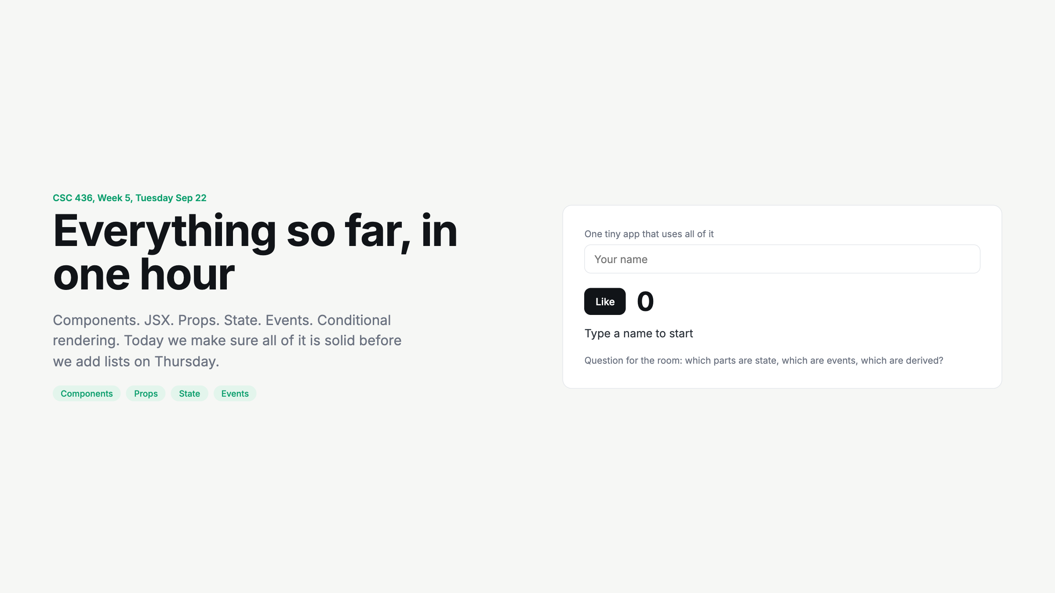
Notes:
Cold open. Have a student type their name and click Like. Ask the three questions. State: who, likes. Event: onChange, onClick. Derived: the sentence.

Slide 2
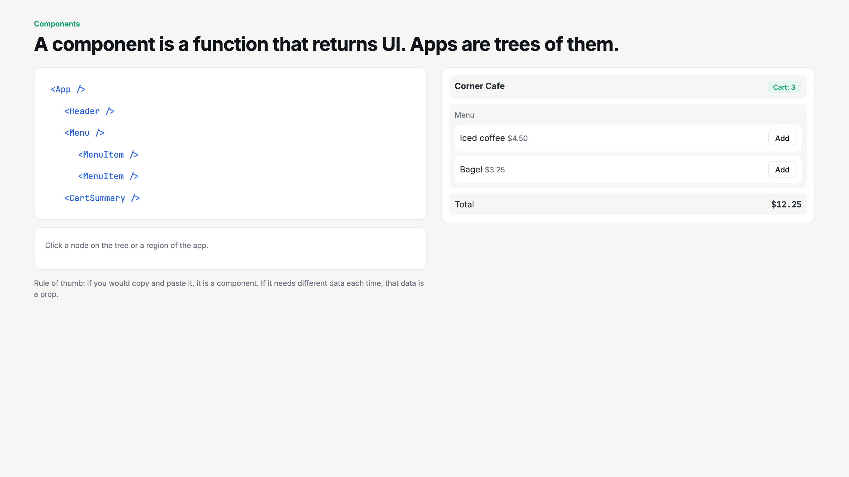
Notes:
Click App first, then a MenuItem. Push on: why is MenuItem reused? Where does the cart live and why not inside MenuItem?

Slide 3
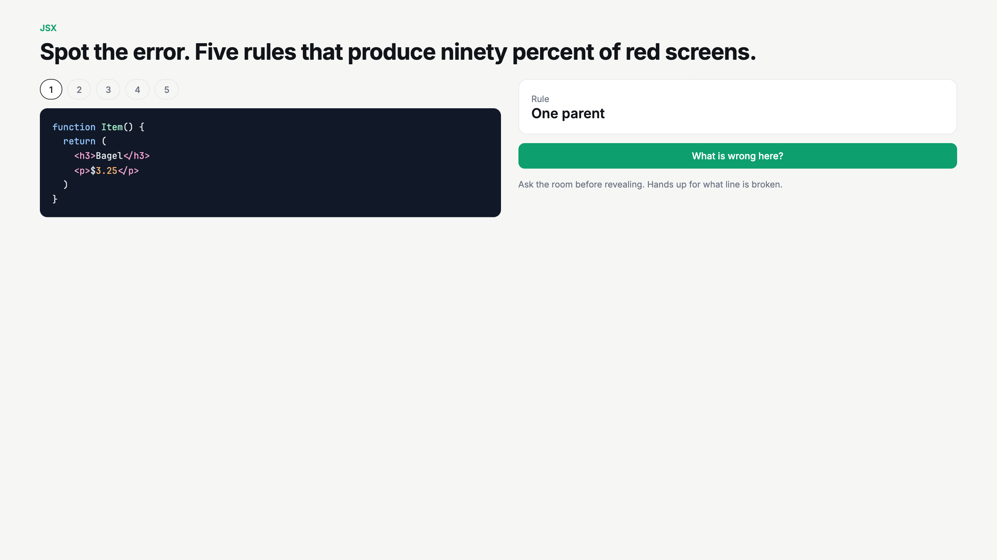
Notes:
Rapid fire. 60 seconds per case. Hands up for the broken line, then reveal. Case 5 catches people who think naming is cosmetic.

Slide 4
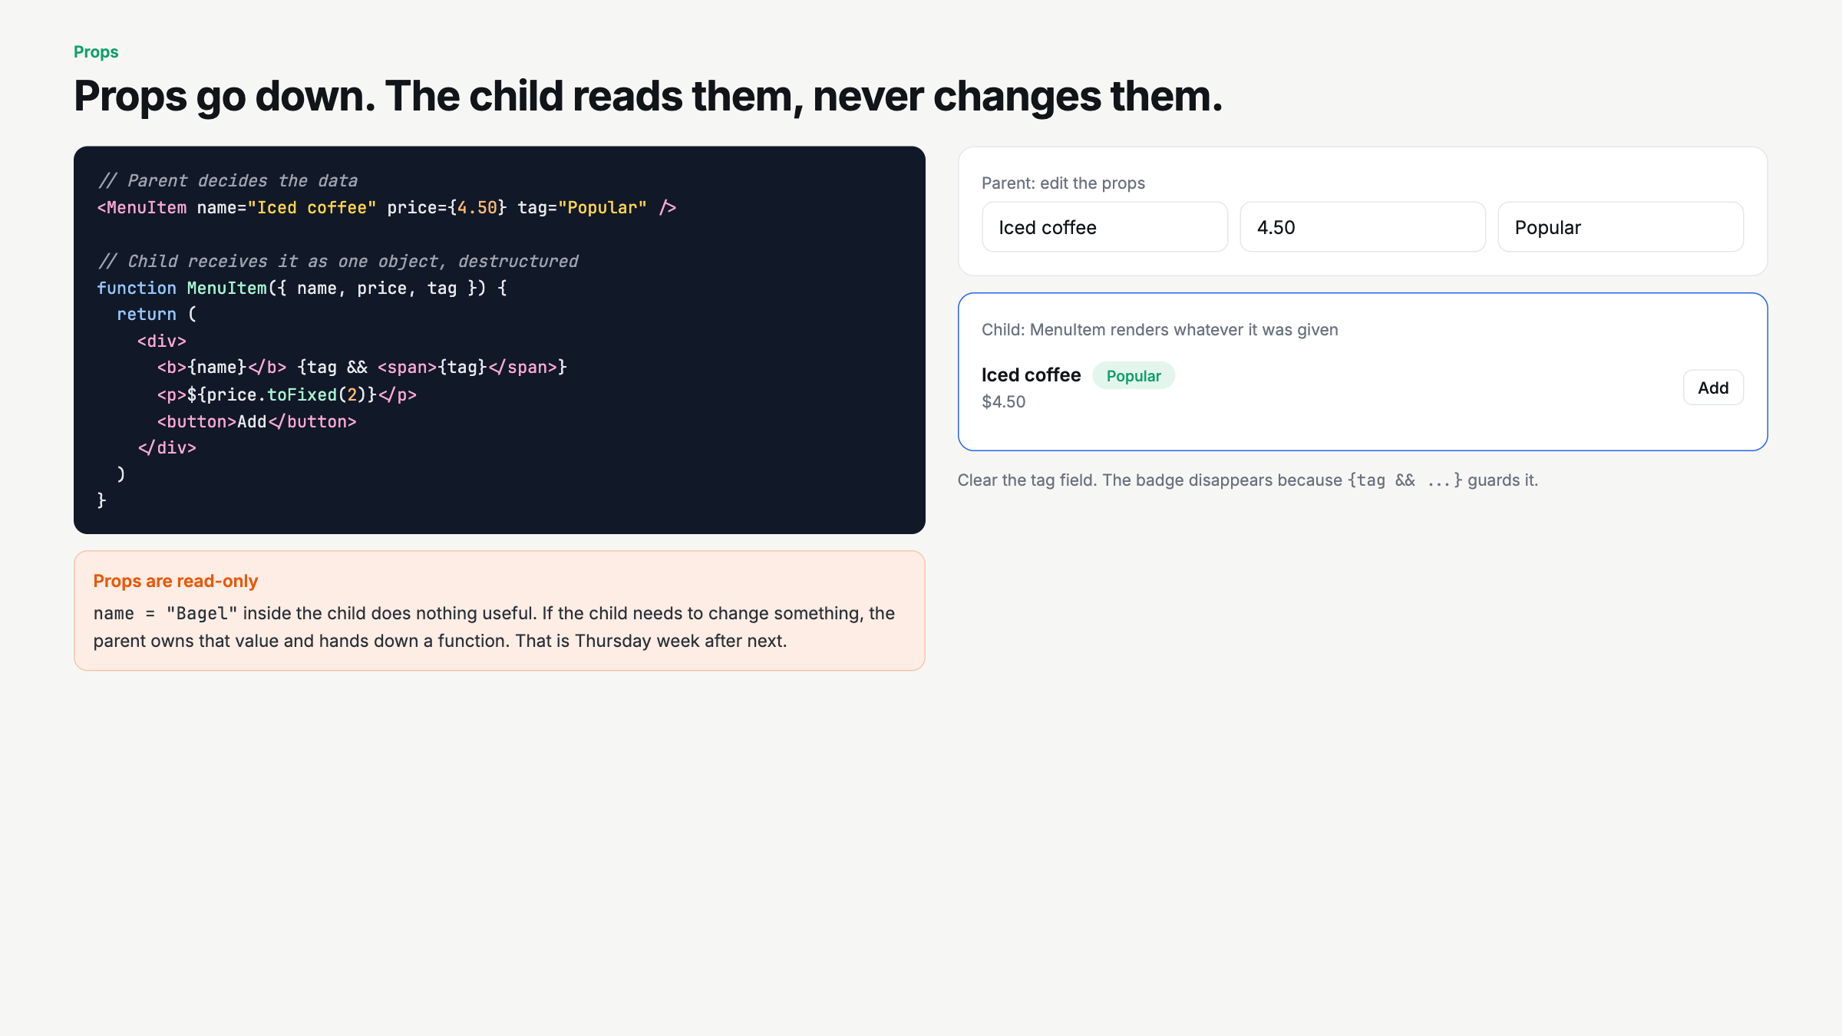
Notes:
Edit the props live. Then clear the tag field. Ask: could MenuItem change its own price? No. Plant the lifting state seed for next week.

Slide 5
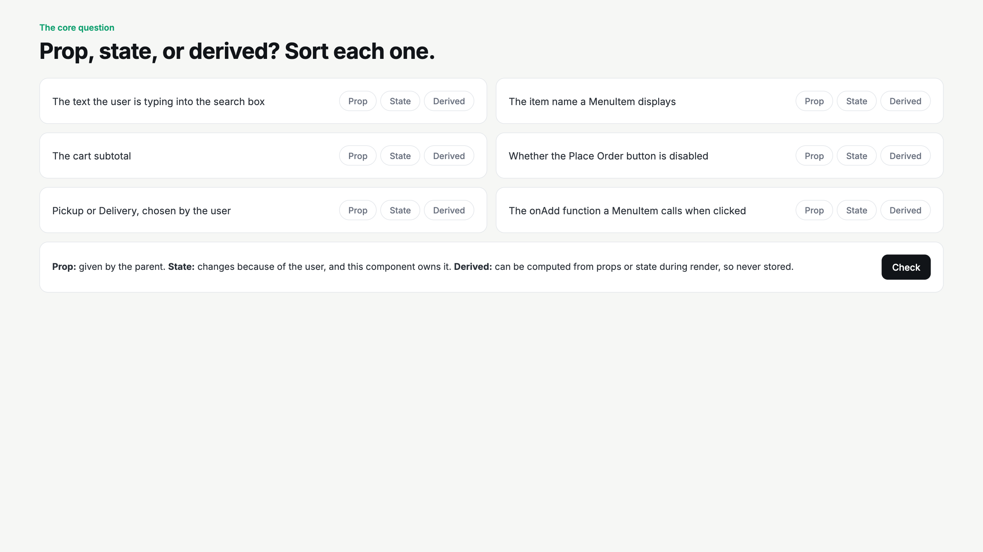
Notes:
Do this as a whole room vote per card before Check. The subtotal and disabled cards are the ones people get wrong. Repeat: store facts, compute views.

Slide 6
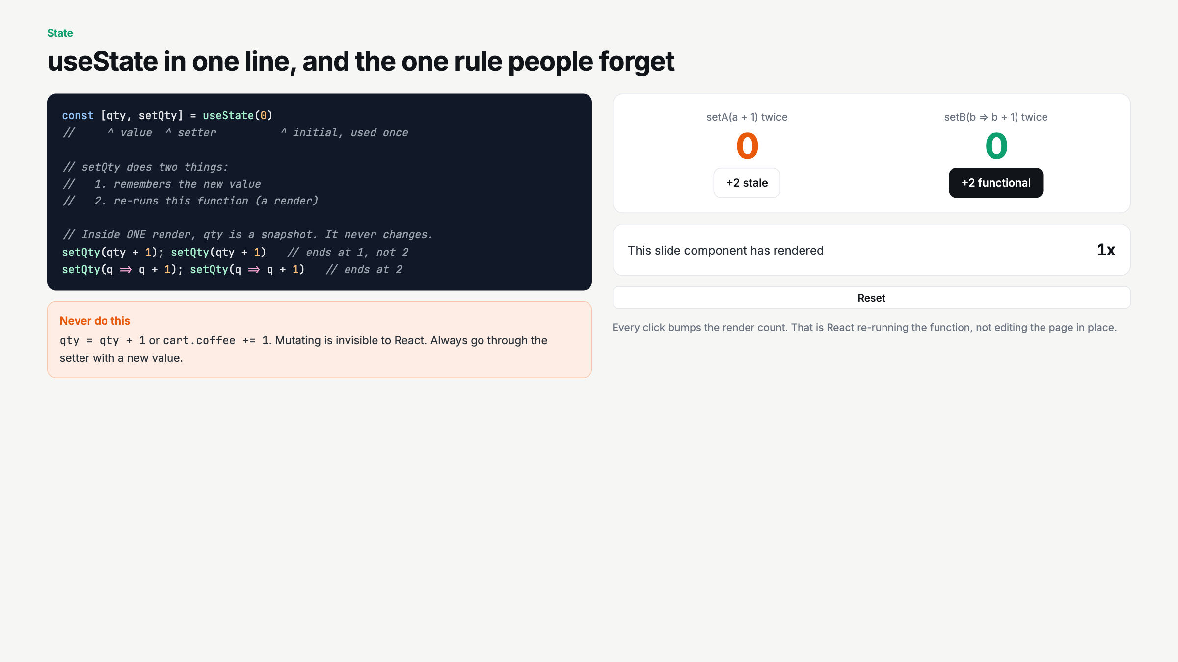
Notes:
Snapshot rule again. Click stale then functional. Point at the render counter every time. This is the bridge to Thursday's array updates.

Slide 7
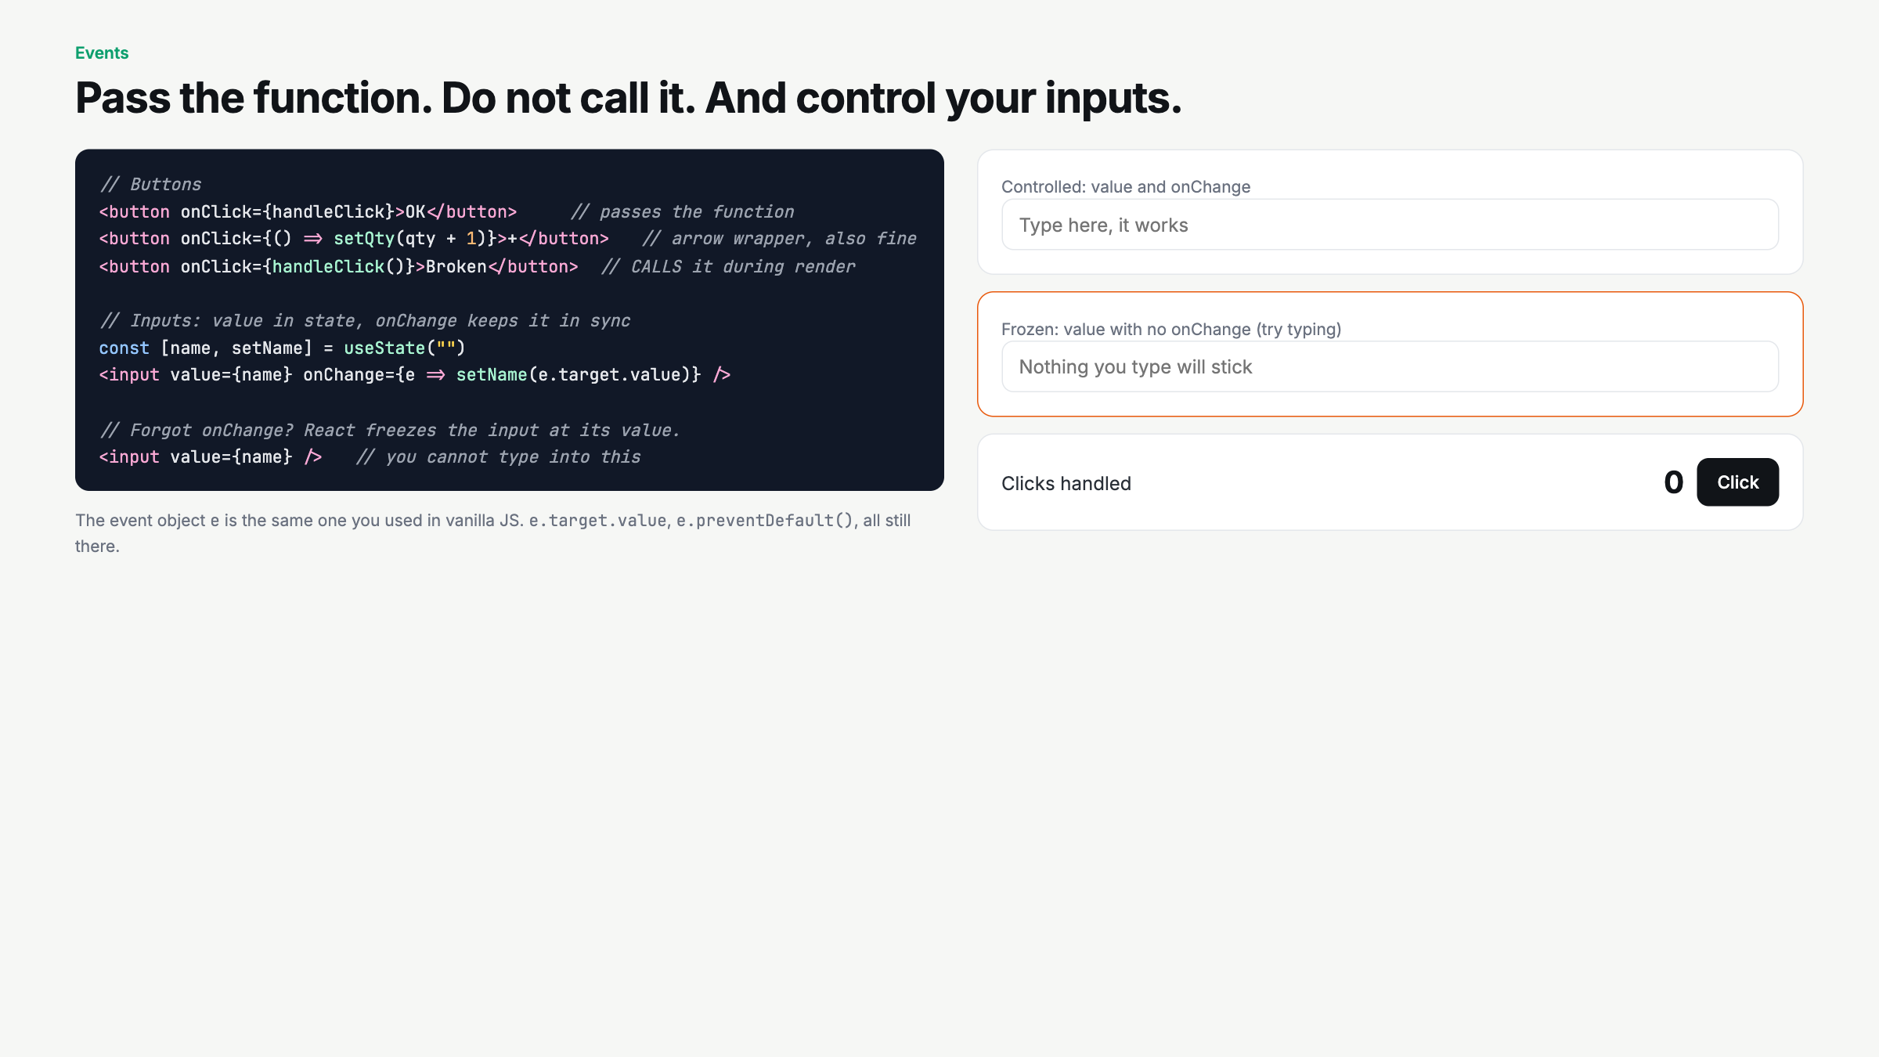
Notes:
Have a student try the frozen input. Then explain why: state wins on every render. Preview: Thursday uses e.preventDefault on a form.

Slide 8
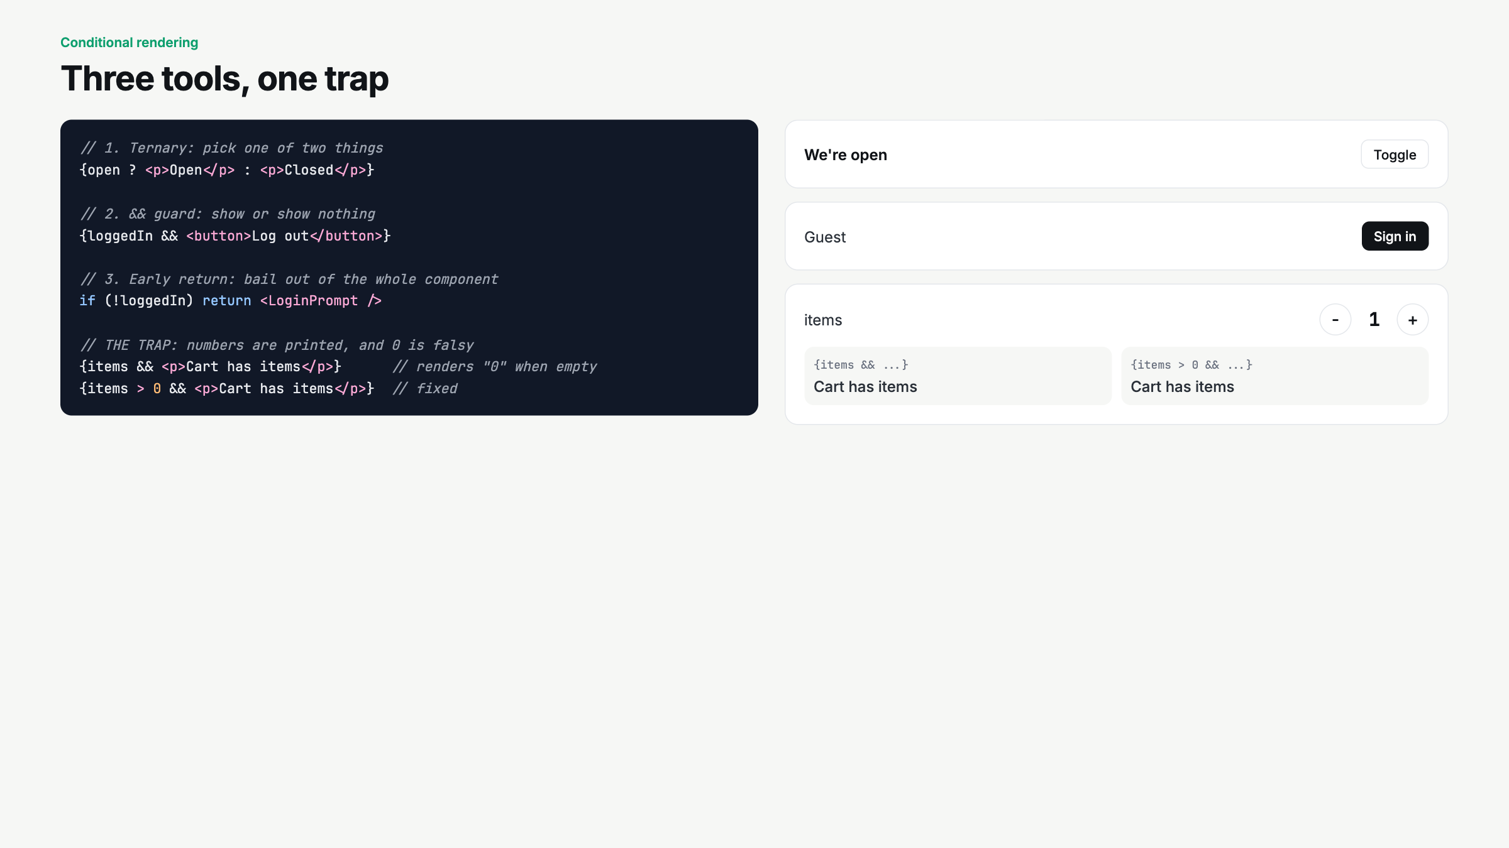
Notes:
Quick. Toggle each one. Set items to 0 and let them spot the stray zero without pointing.

Slide 9
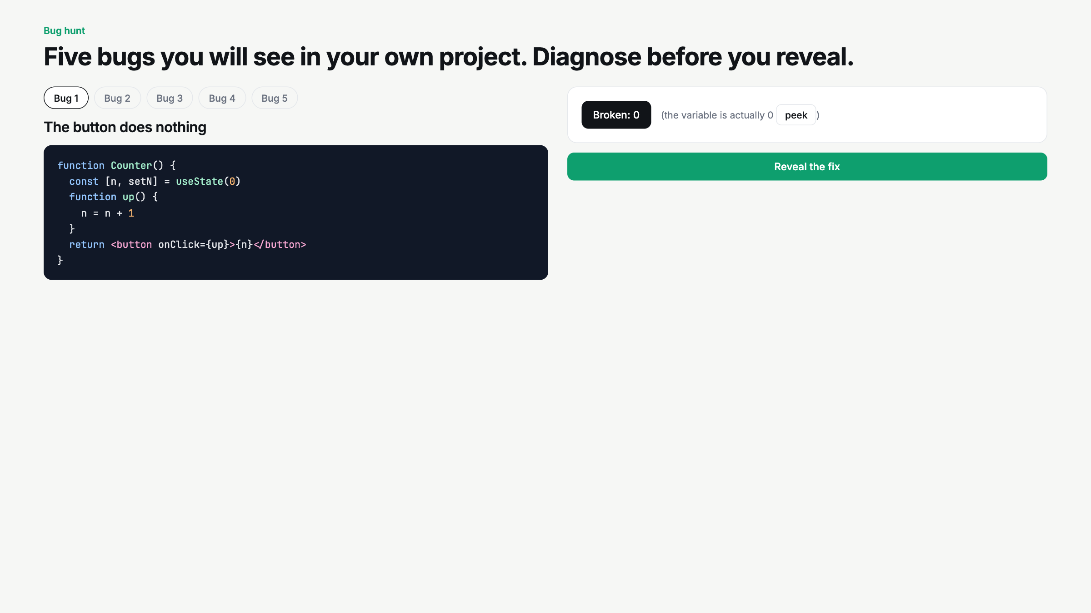
Notes:
This is the heart of the review. Pair up, 90 seconds per bug to diagnose, then reveal. Bug 3 is not run live. Bug 2 is the one that will bite them on Thursday with arrays.

Slide 10
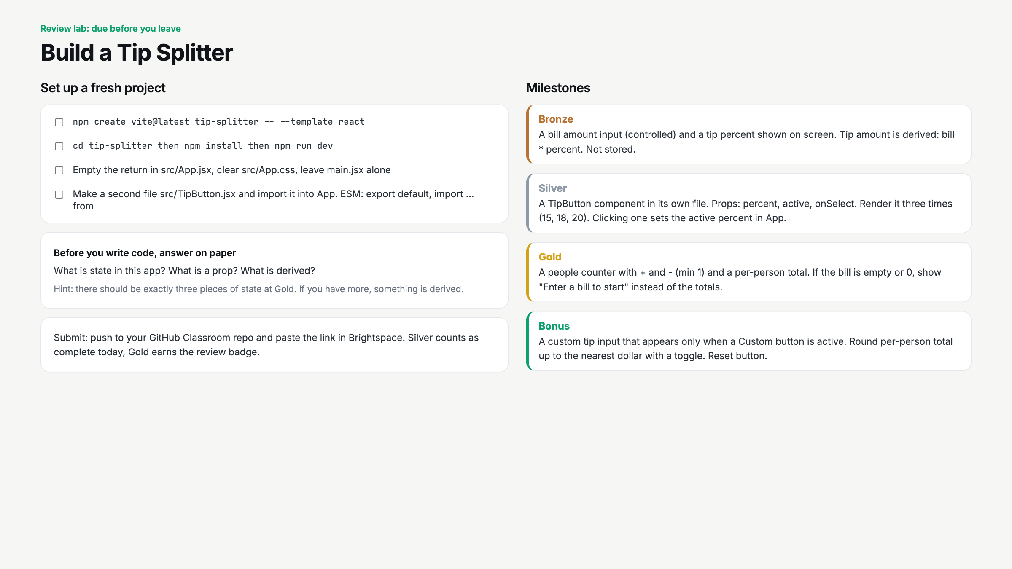
Notes:
Read the paper question out loud and make them answer it before npm create. Circulate for derived-stored-as-state. Silver is the bar today.

Slide 11
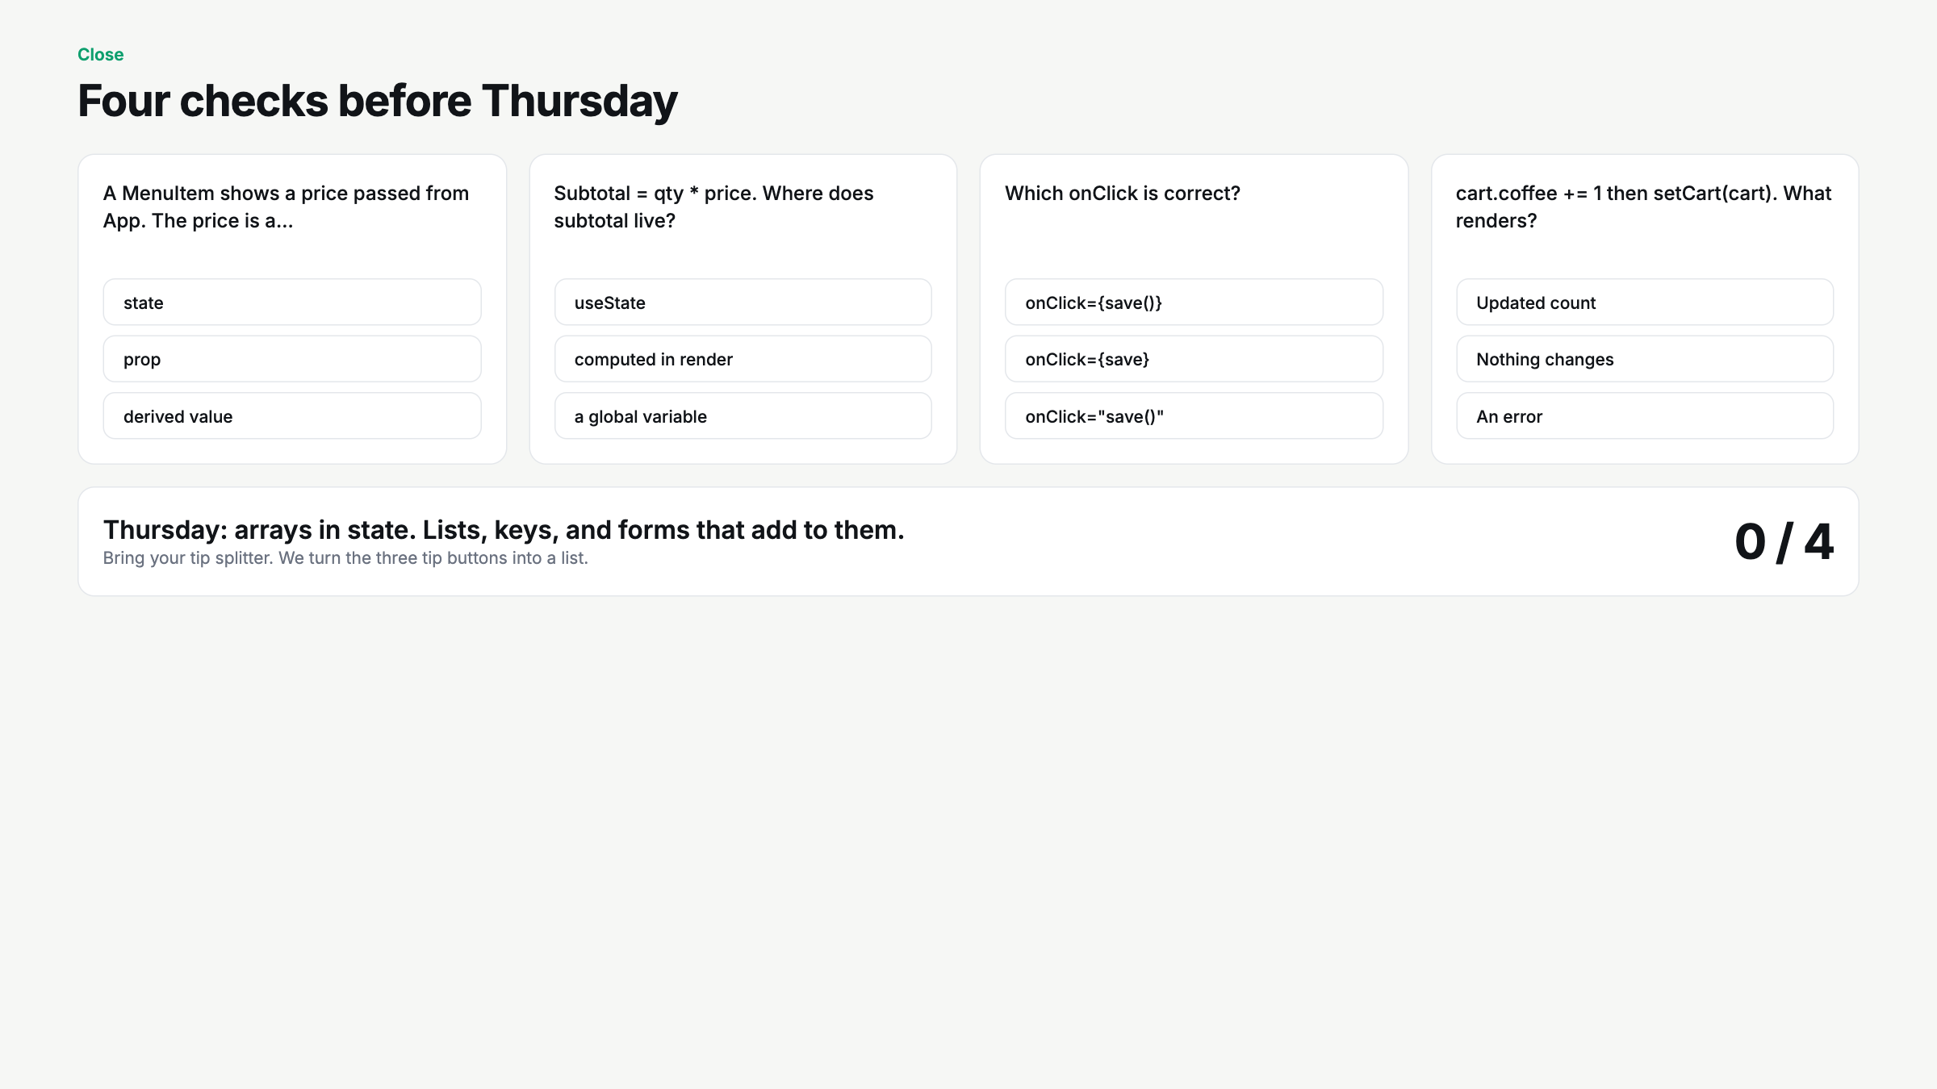
Notes:
Hands up per question. Q4 is the setup for Thursday: same reference means no render. Arrays work the same way.

